Slide 1
Restaurant List App
Team-5
Priyanka Ramesh
Pavan Bojanapu
Vigneshwar Ravi
Varun Srinivas
Nabin Mahato

Slide 2
TEAM COLLAB0RATION
Work done | Name
Frontend | Vigneshwar Ravi, Nabin Mahato
Backend | Priyanka Ramesh, Pavan Kumar, Varun Srinivas
Devops | Pavan Kumar, Vigneshwar Ravi, Priyanka Ramesh, Varun Srinivas, Nabin Mahato

Slide 3
TECHNOLOGIES USED
Java / Java Spring boot
Git
Maven
Jenkins
Nexus
AWS
Docker
Kubernetes
UI (html + CSS + JS )
MySQL workbench
Swagger
Mongodb

Slide 4
ADMIN OPERATIONS
Add a Restaurant
Delete a Restaurant
Update a Restaurant
View a Restaurant

Slide 5
USER
Sign in/Sign up
View list of Restaurant
Book a Table
Payment Method
View Bookings
Download Receipt

Slide 6
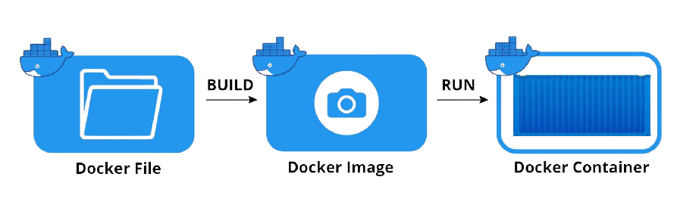
DOCKER

Slide 7
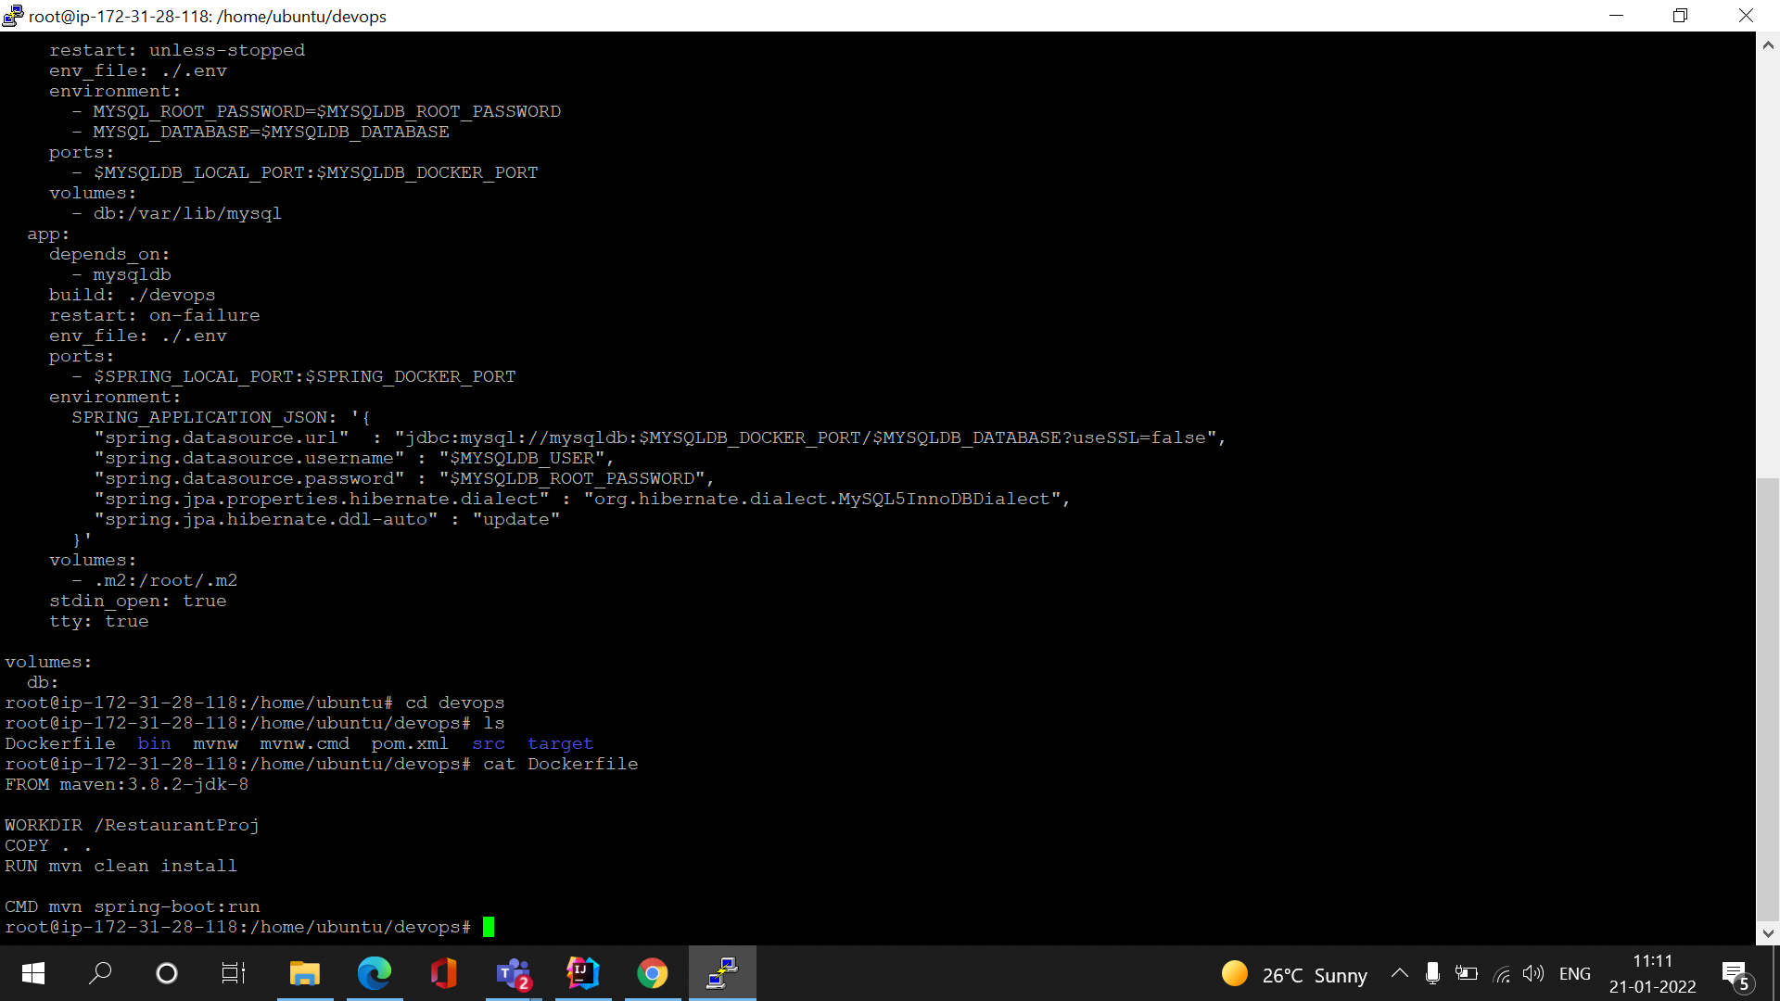
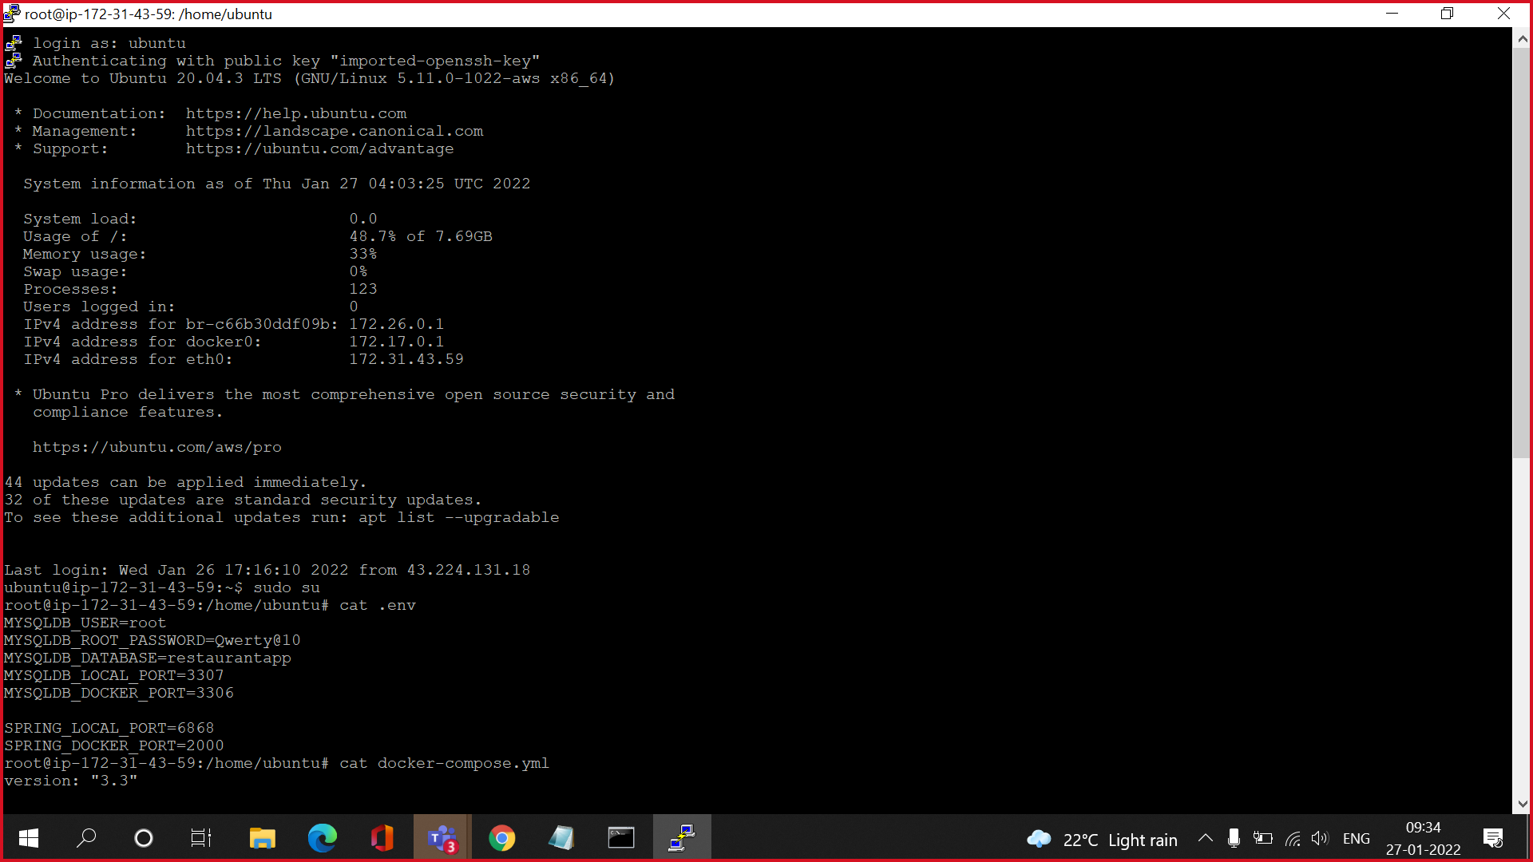
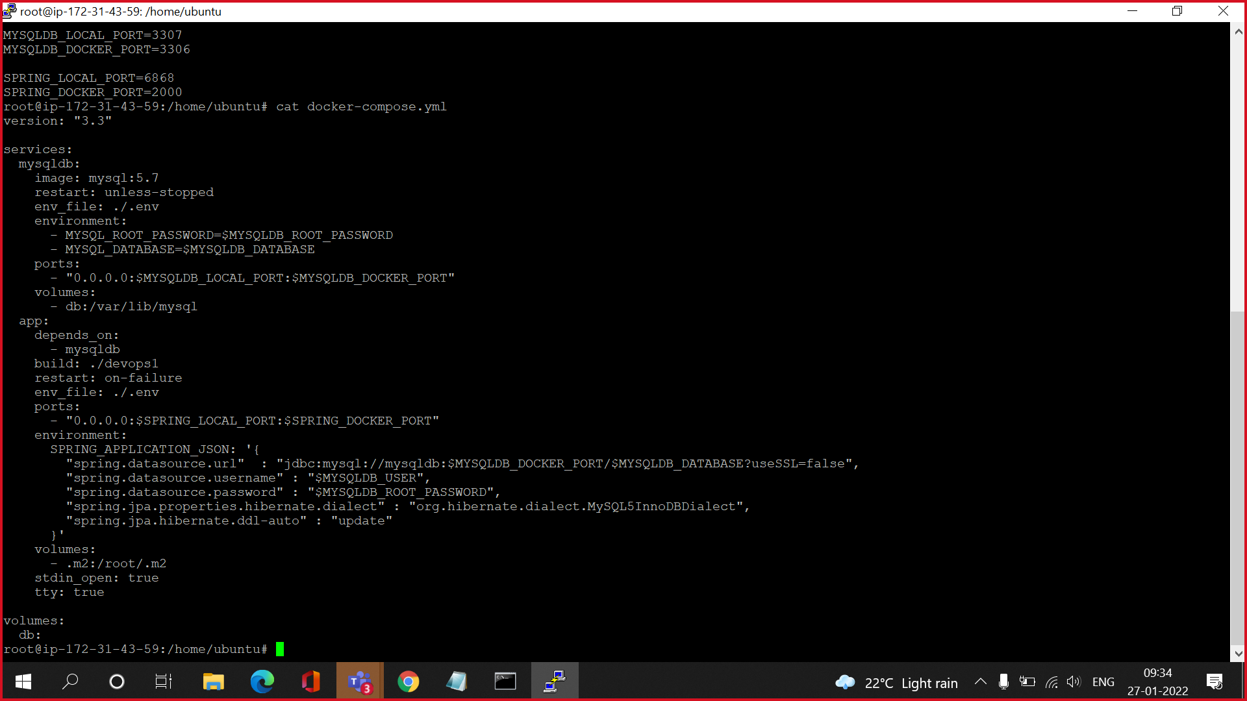
1. Dockerfie
2. .env file
3. docker-compose

Slide 8
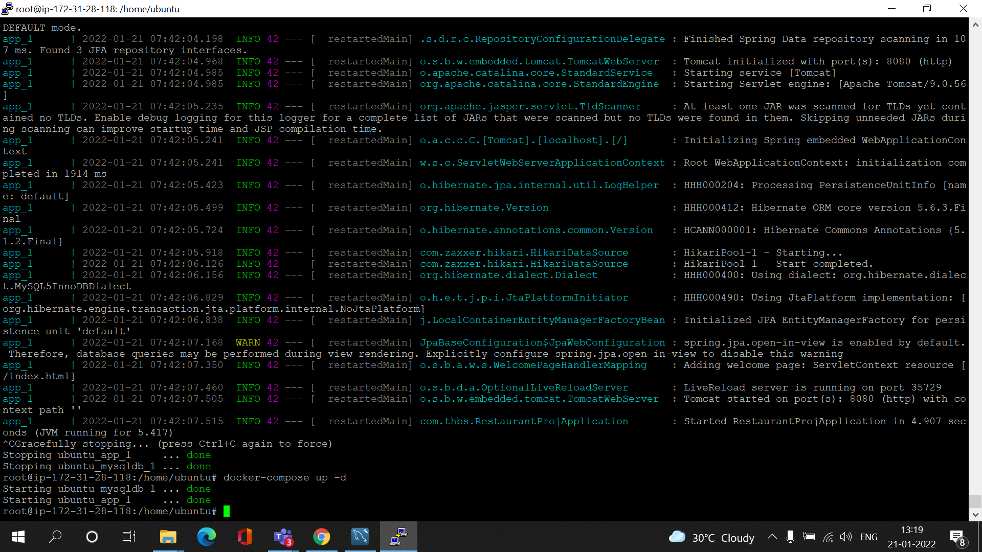
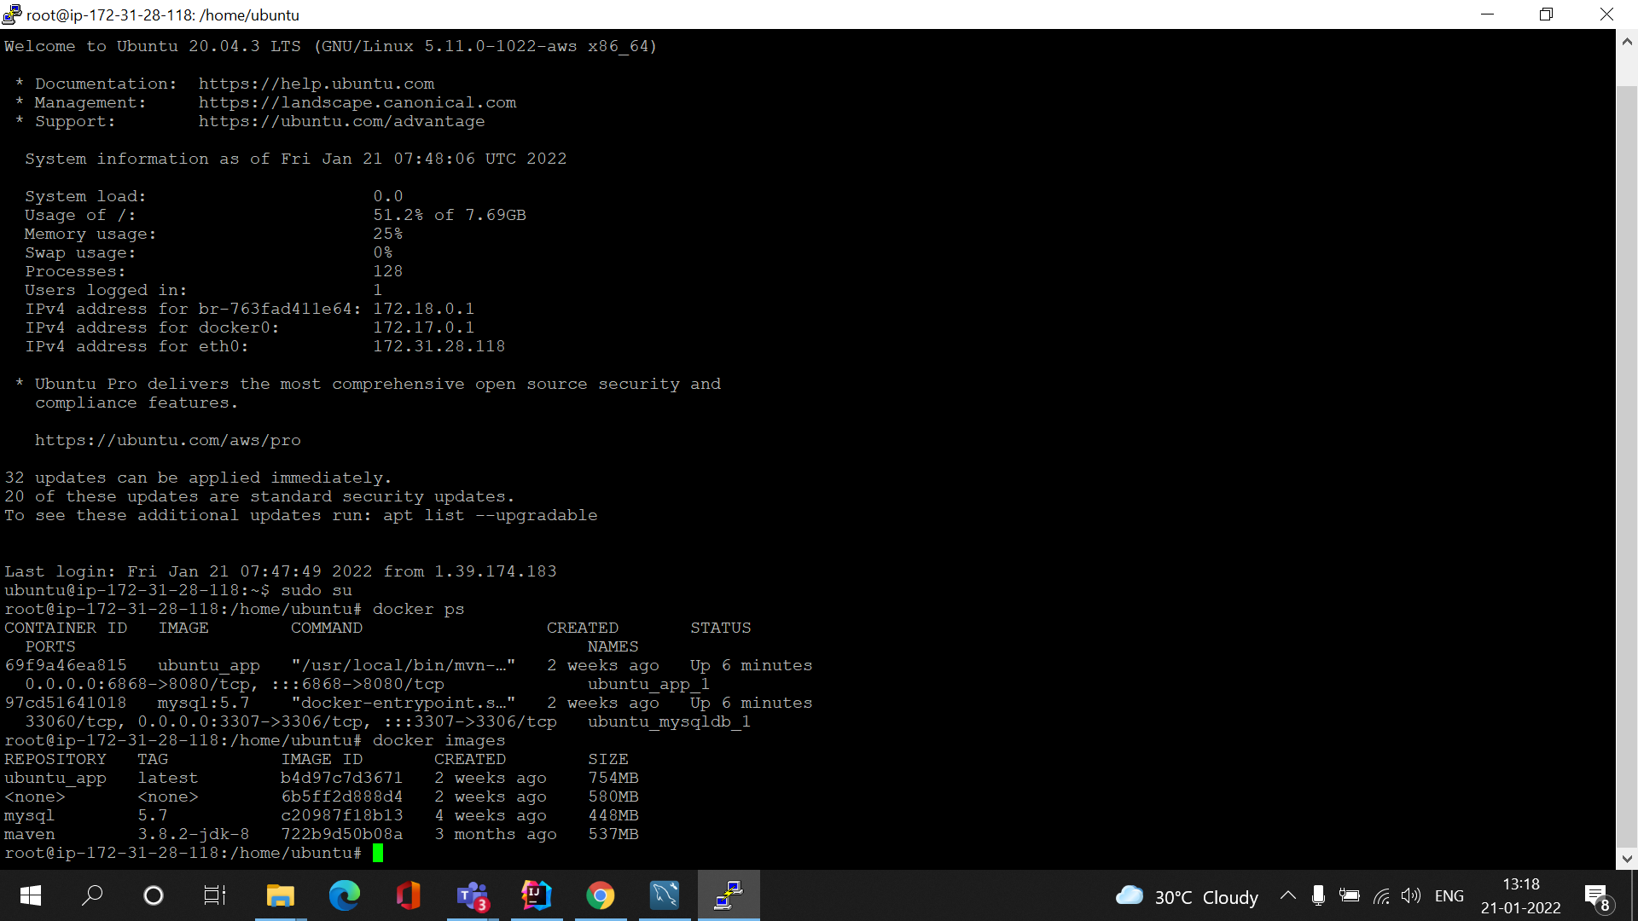
3. docker-compose up command to Run DOCKERFILE and docker-compose file
4. docker images are created
5. docker containers

Slide 9


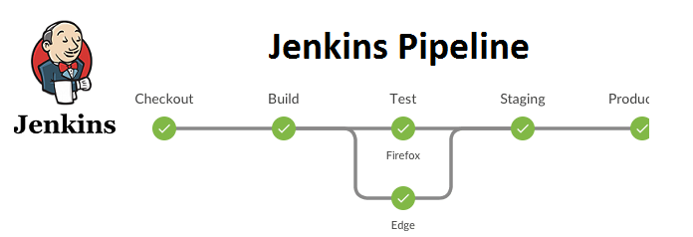
GIT – JENKINS - NEXUS
TRIGGERS

Slide 10
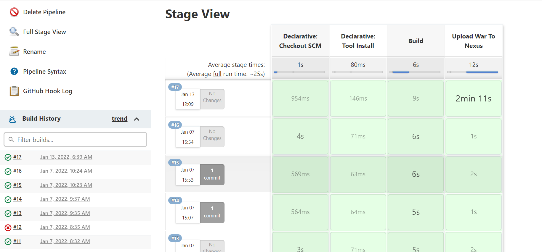
Jenkins Pipelines

Slide 11
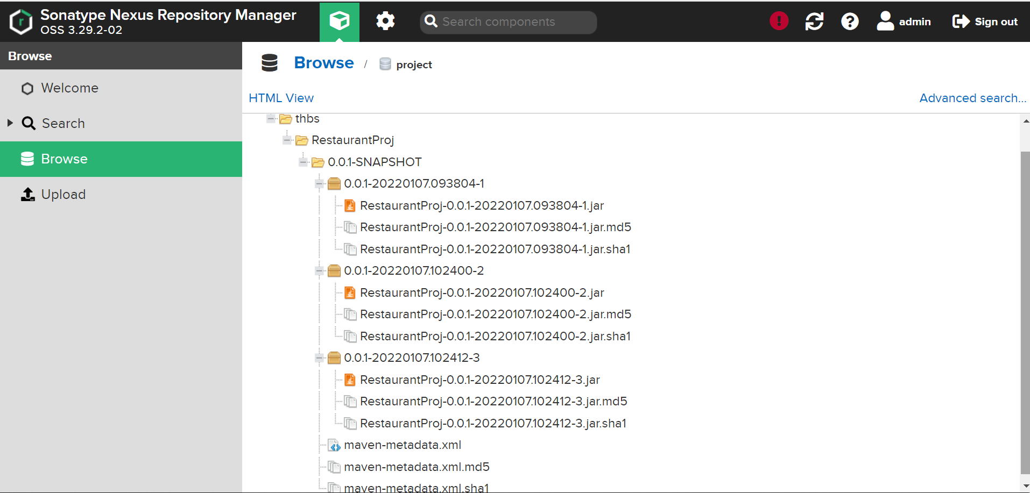
Nexus Repository

Slide 12
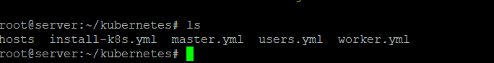
ANSIBLE - KUBERNETES
SERVER
SSH
SSH
MASTER
WORKER
1. Created directory KUBERNETES in server containing PLAYBOOKS

Slide 13
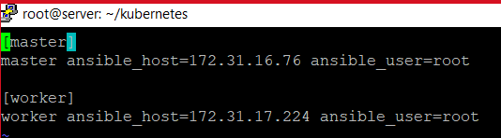
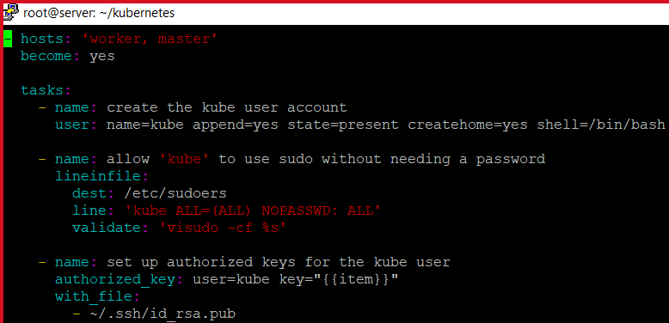
2. HOSTS file contains IP ADDRESS of MASTER and WORKER NODE
3. PLAYBOOK TO CONFIGURE KUBERNETES IN BOTH MASTER AND WORKER

Slide 14
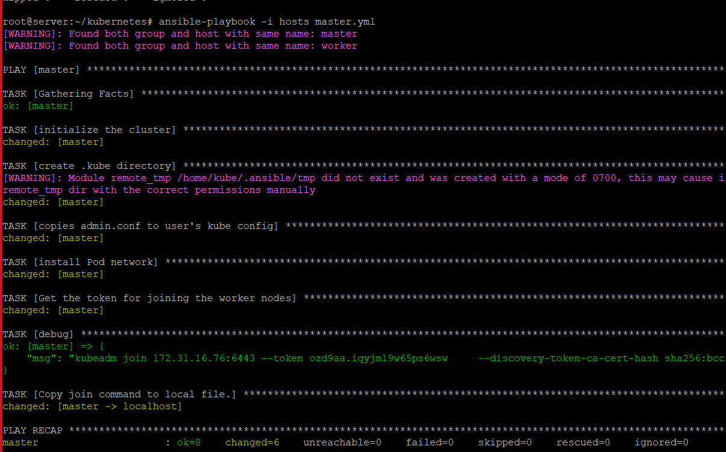
4. INSTALLING KUBERNETES IN BOTH MASTER AND WORKER USING install-k8s PLAYBOOK
5. SETTING UP MASTER CONFIGURATION FOR ONLY MASTER NODE USING PLAYBOOK

Slide 15
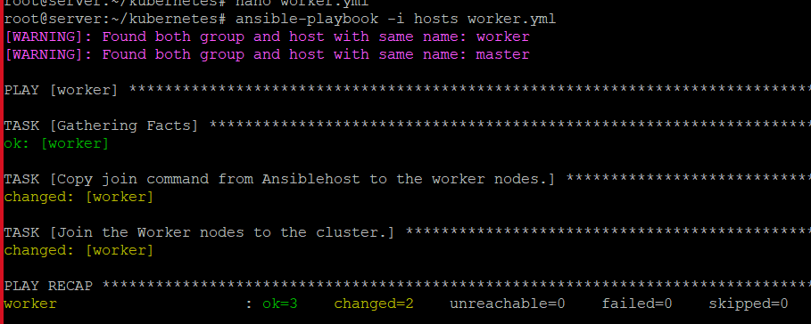
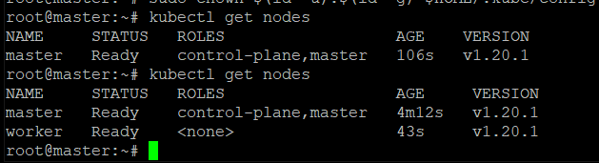
6. SETTING UP WORKER CONFIGURATION FOR ONLY WORKER NODE USING PLAYBOOK
7. MASTER NODE SHOWING ITS CONNECTION

Slide 16
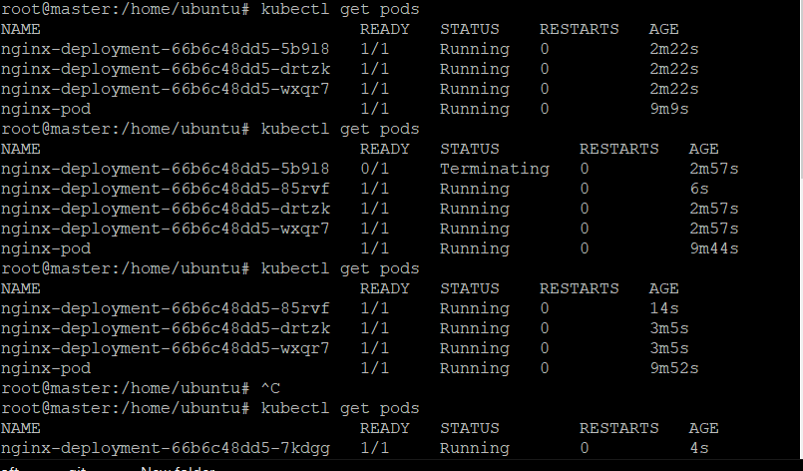
8. PODS BEFORE AND AFTER DELETING

Slide 17
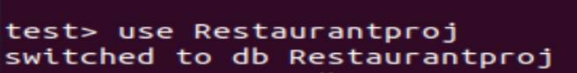
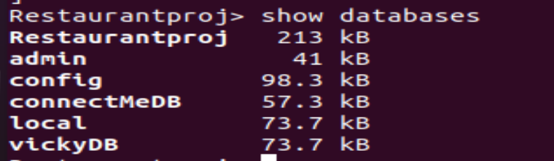
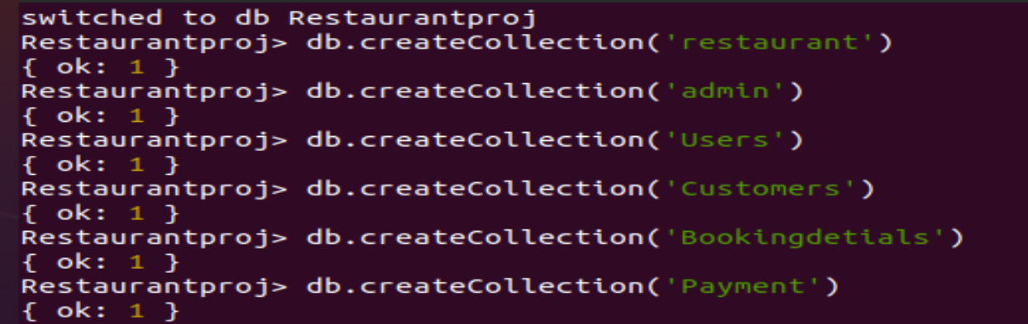
MONGO DB
1. Creating Database
2. Show Database
3. Creating Collections

Slide 18
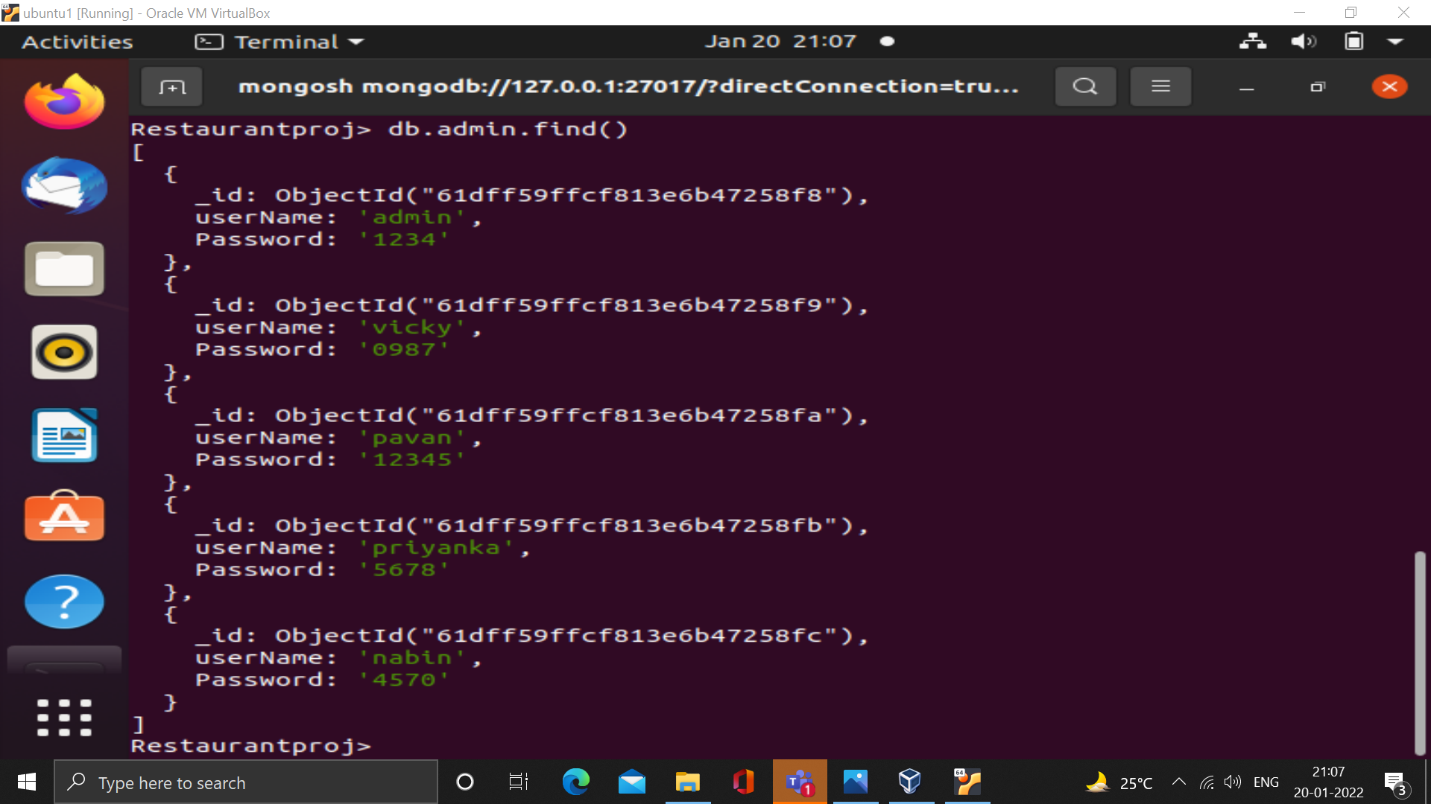
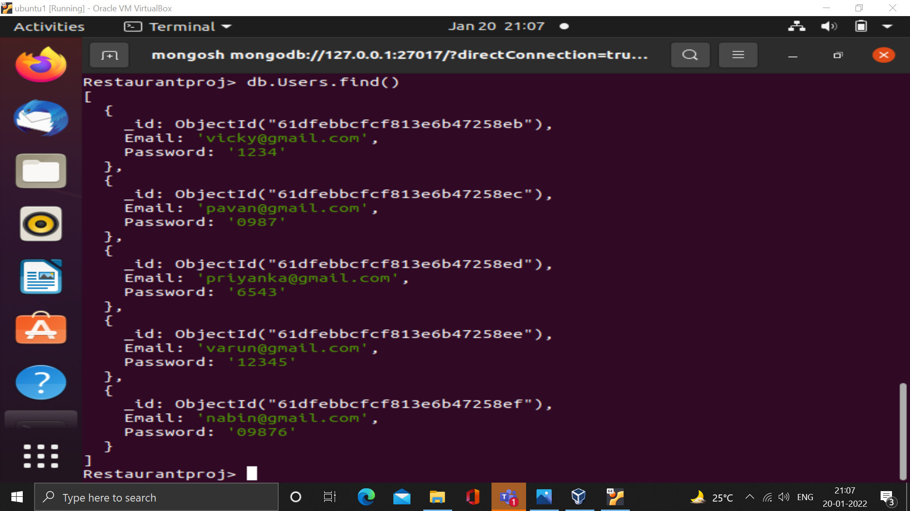
4. Displaying Admin Credentials
5. Displaying User Credentials

Slide 19
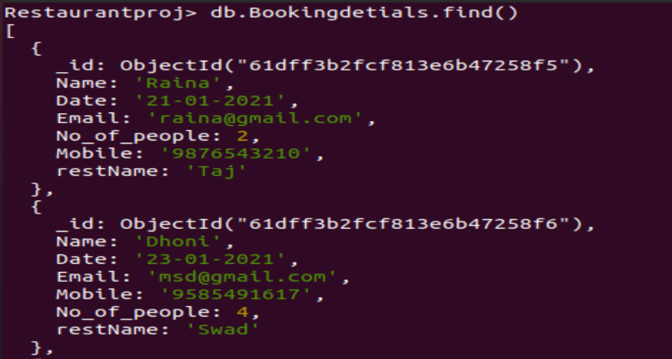
7. Booked Details

Slide 20
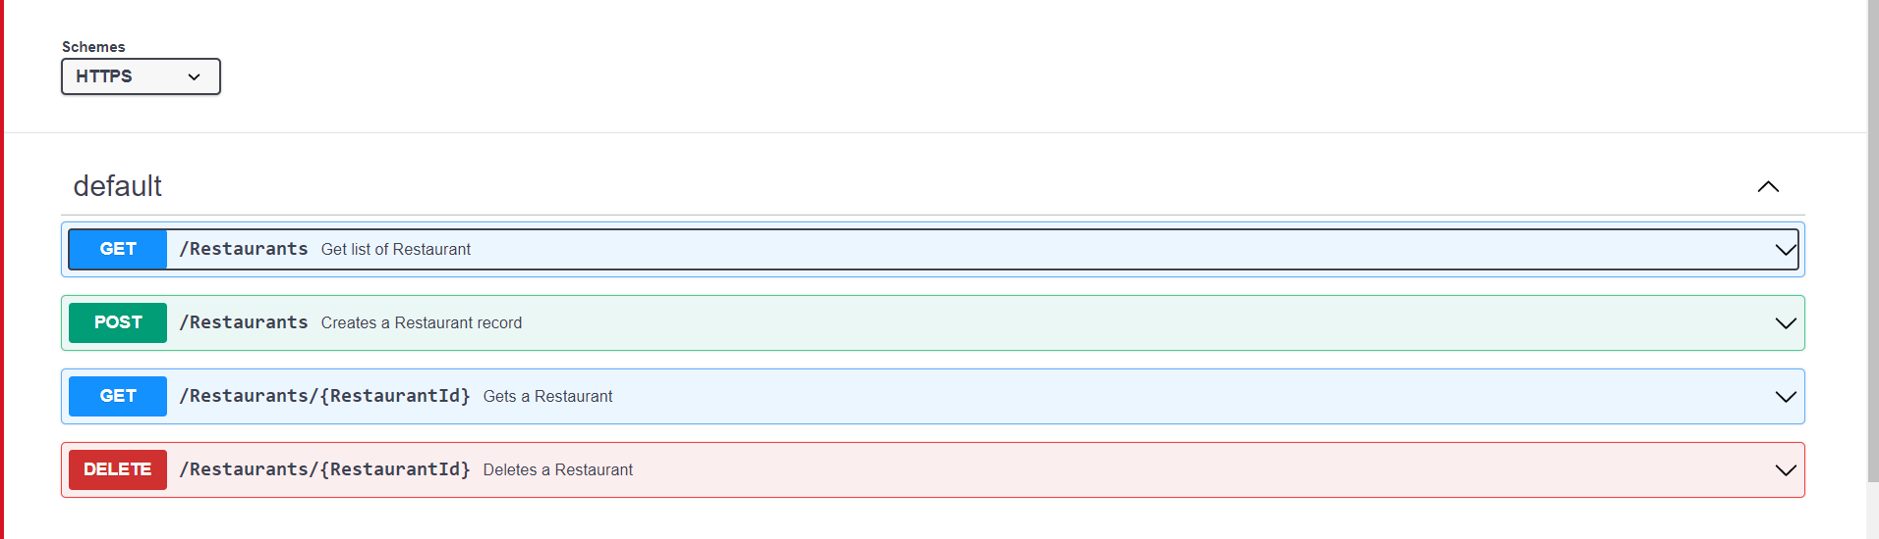
SWAGGER
List of API’s in Swagger

Slide 21
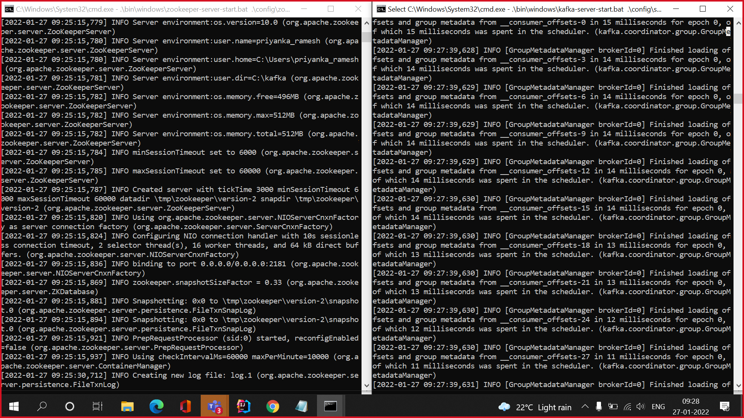
KAFKA
1. Kafka Connections

Slide 22
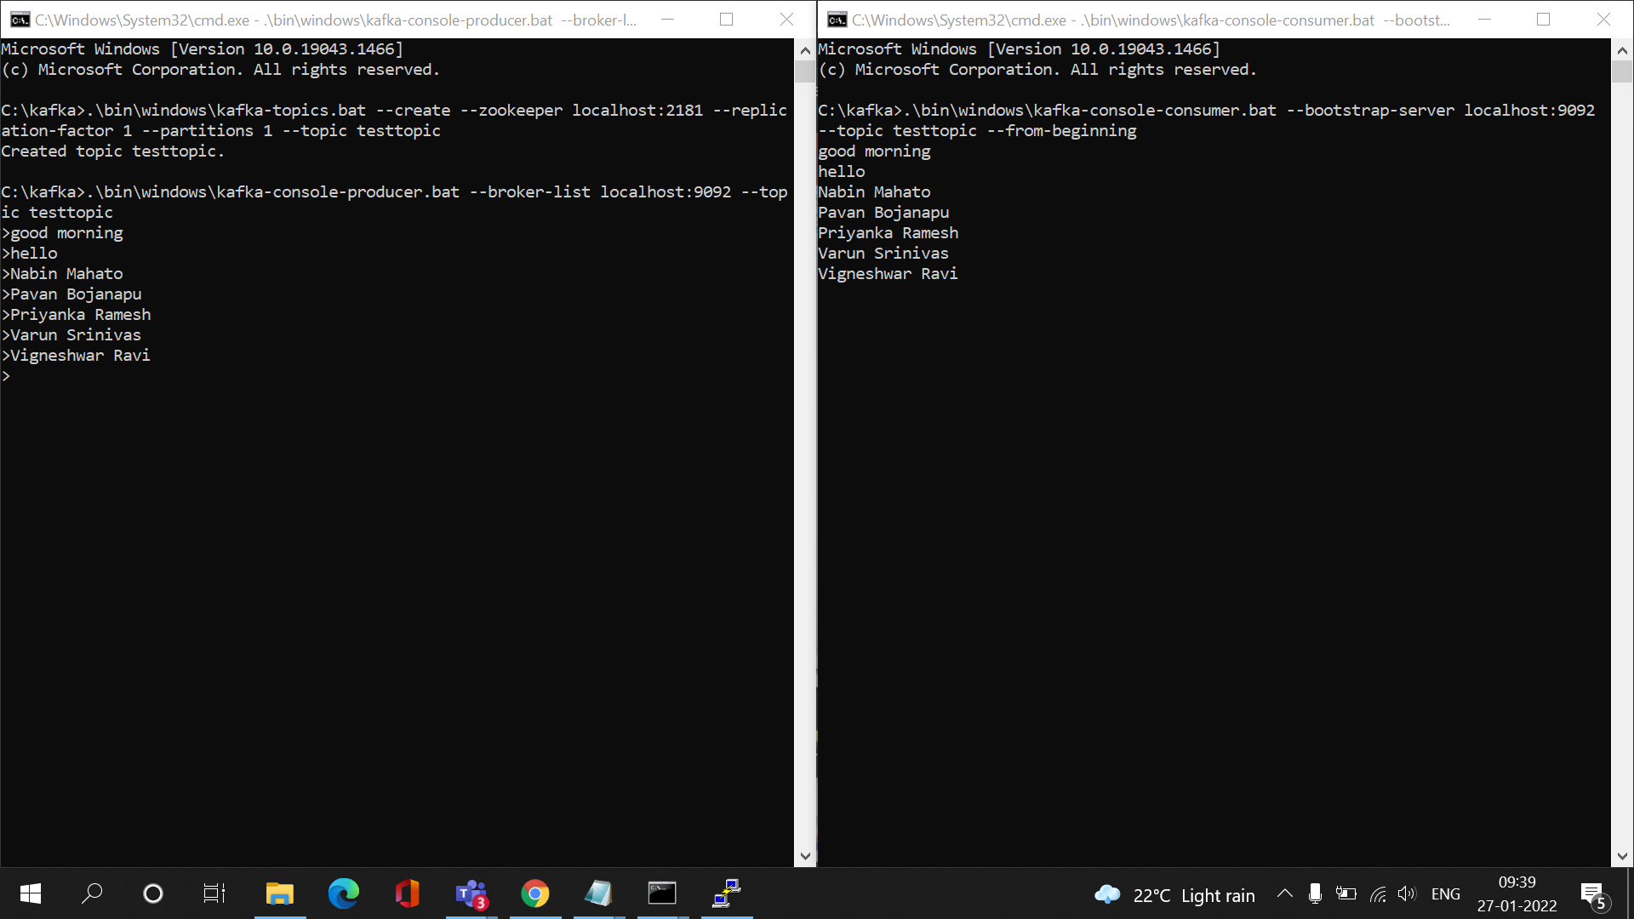
2. Producer and Consumer

Slide 23
THANK YOU

